Slide 1


Birla Vishvakarma Mahavidhyalaya Enginerring College Information Technology Department IT442 - Minor Project II(UDP)
Crowd Computing
Group G3
Keval Padsumbiya (17IT405)
Maulik Beladiya (17IT409)
Gopal Sakwala (17IT411)
Neel Savani (17IT469)
HOD Dr. Keyur Brahmbhatt
Guide Prof. Prachi K Shah

Slide 2

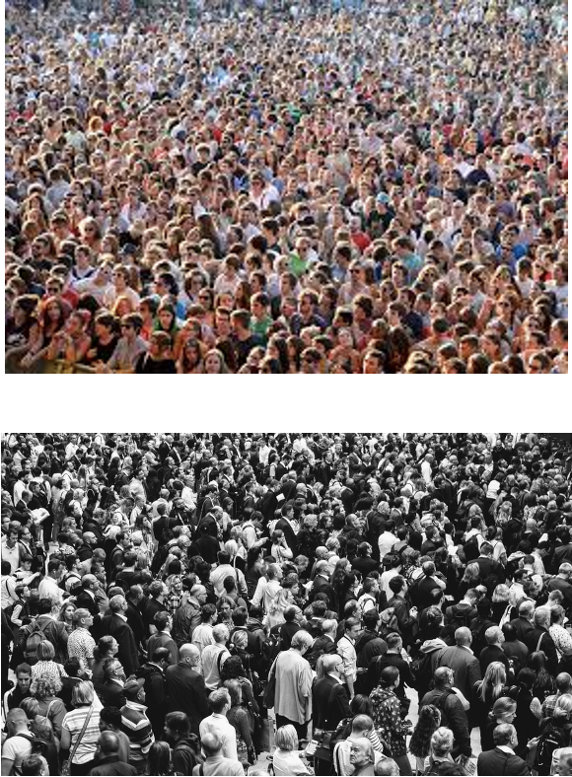
Overview
Crowd Counting is a difficult problem especially in dense crowds due to two main reasons:
There is often clutter, overlap and occlusions present.
In perspective view it is difficult to take into account the shape and size of object present with respect to the background.
While we don’t yet have algorithms that can give us the exact number, most computer vision techniques can produce impressively precise estimates.

Slide 3
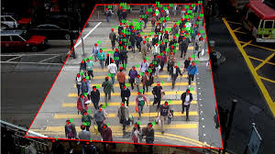
Scope
Crowd counting is essential to serve many real-world applications, such as resource management, traffic control, security, disaster management etc
This model can be integrated with existing system and use to establish analytics.
It will provide simple user interface to count people within image, so later anyone can make predict about other events.

Slide 4

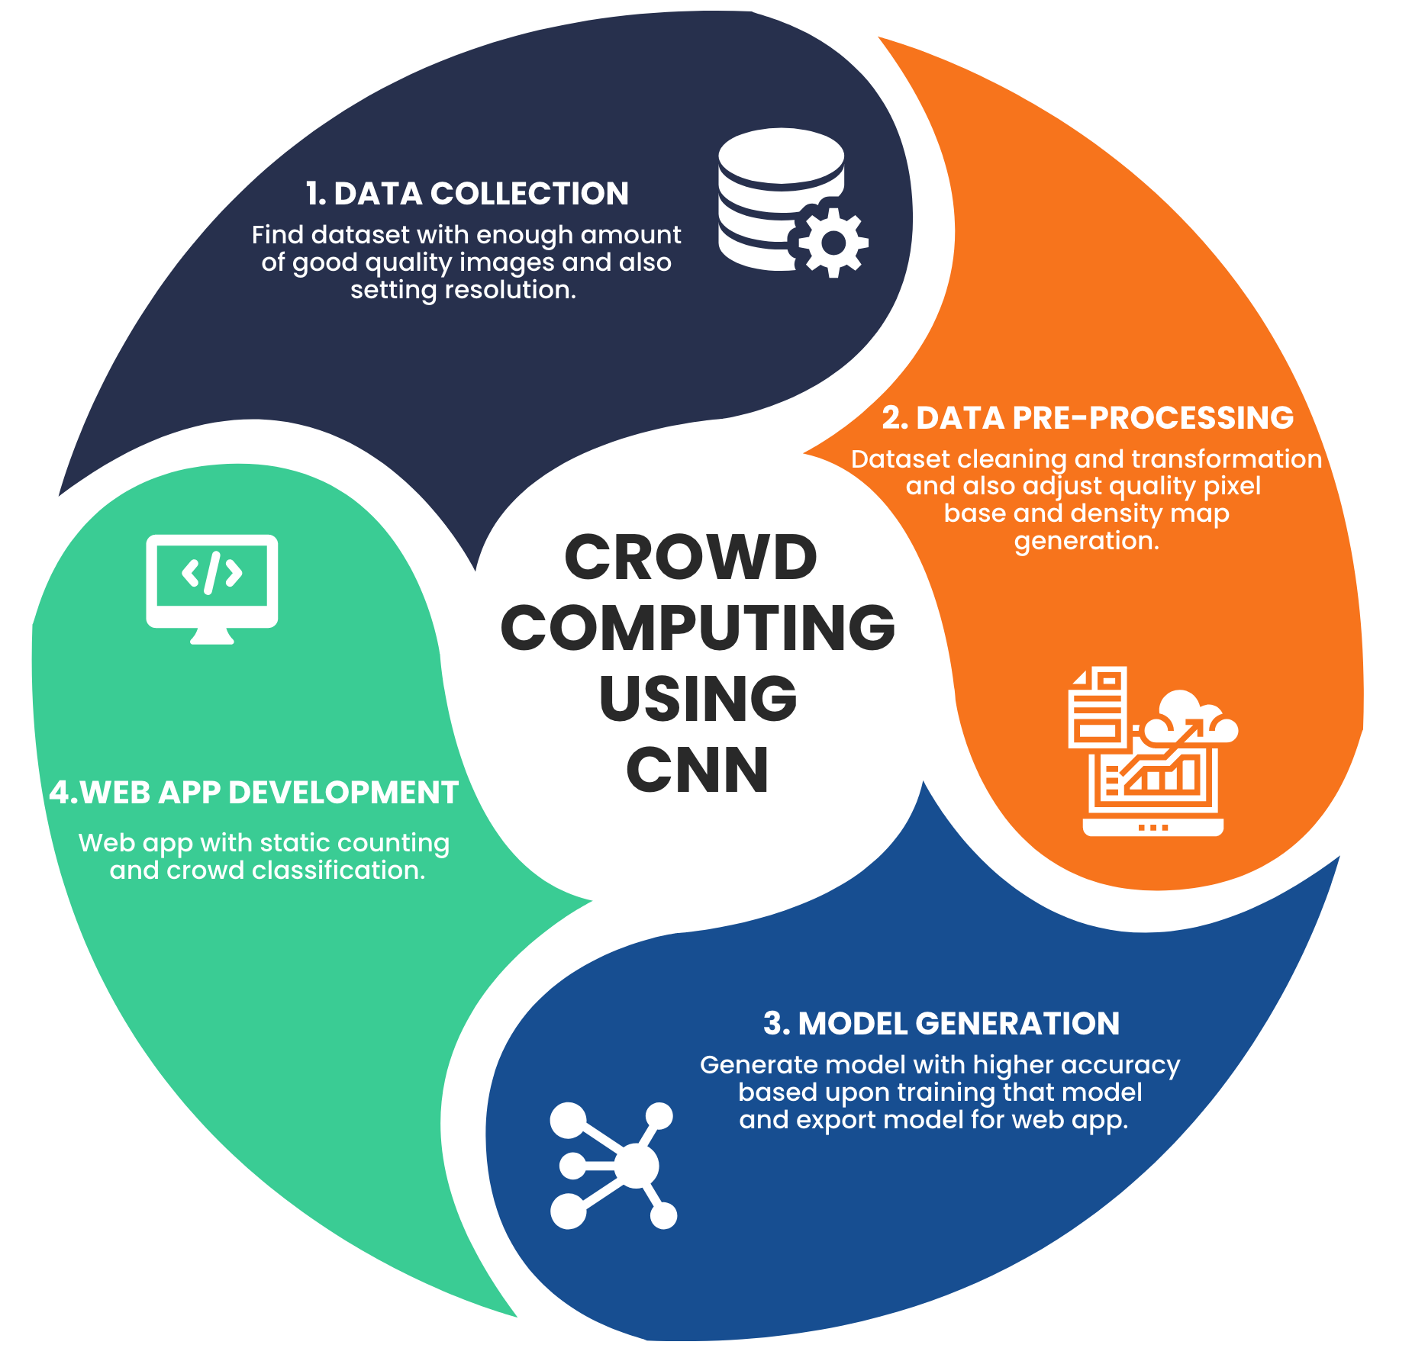
Our Approach

Slide 5

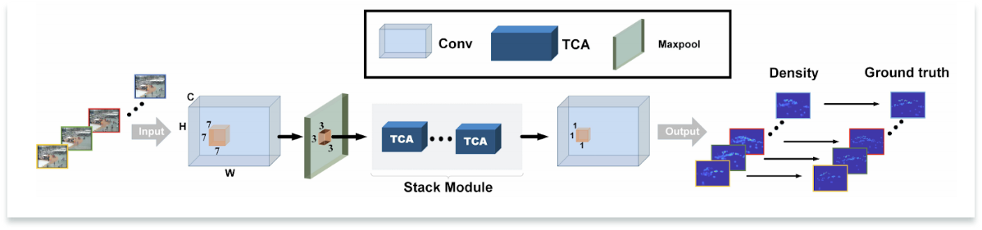
Network Architecture

Slide 6

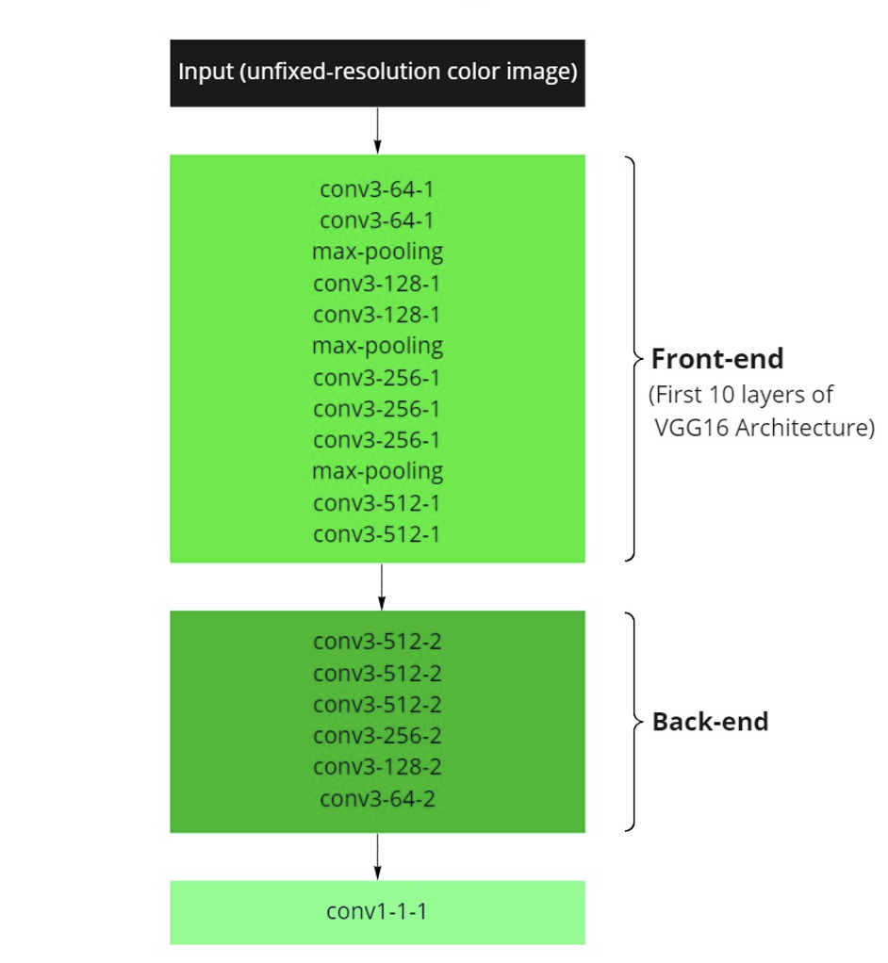
Model Configuration

Slide 7

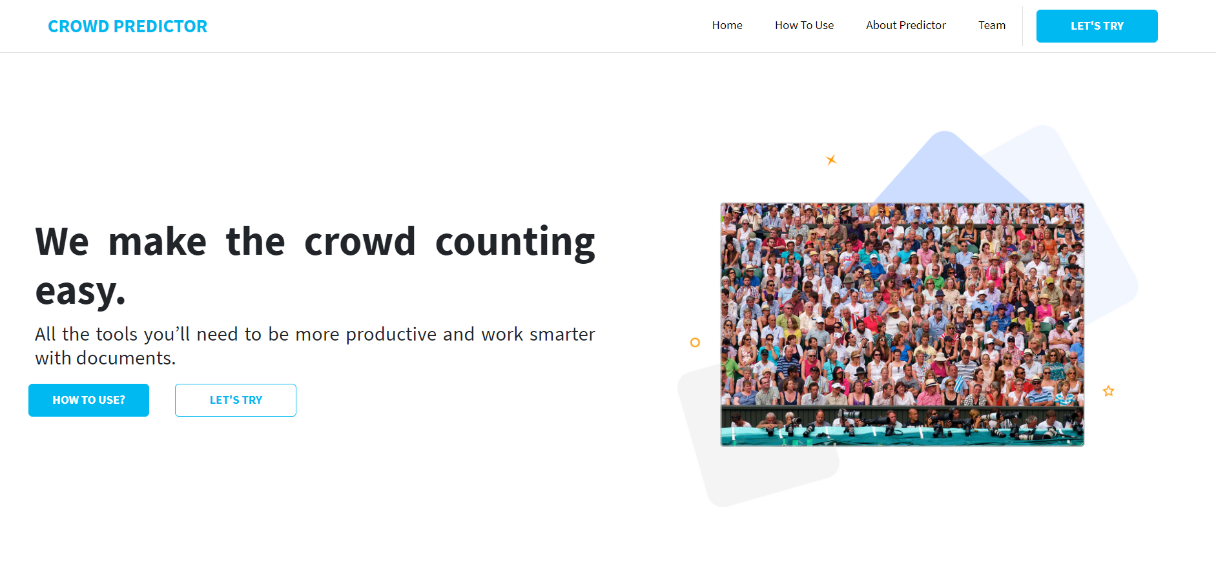
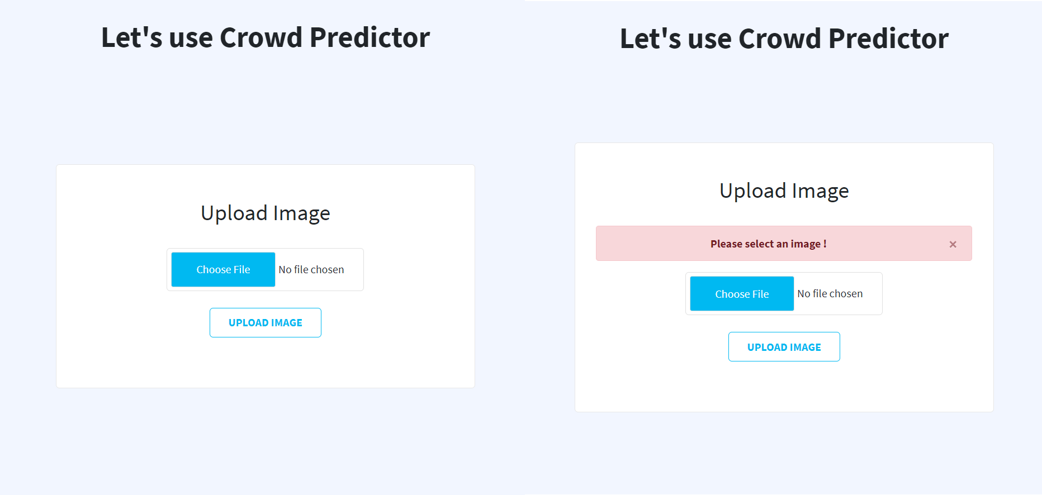
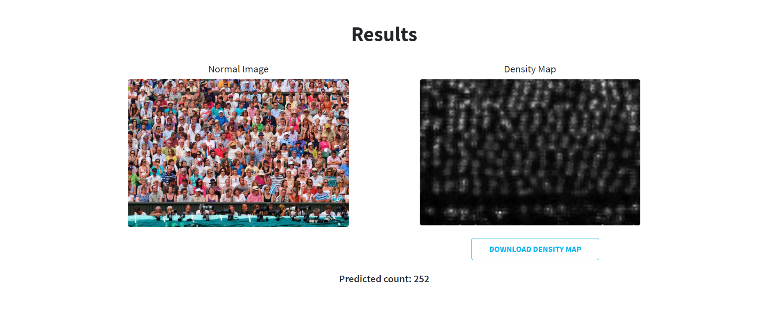
Website

Slide 8

Technologies Used
For pre-processing and model training
Language used : Python
Libraries used : TensorFlow , Keras, PIL, Scipy, Numpy, h5py, OpenCV, Random etc.
For website development
Frontend : HTML, CSS, Javascript and Boostrap.
Backend : Django and Sqlite(database)

Slide 9
THANK YOU

